Slide 1
WELCOME TO THE FUTURE
Yuliia Humeniuk

Slide 2
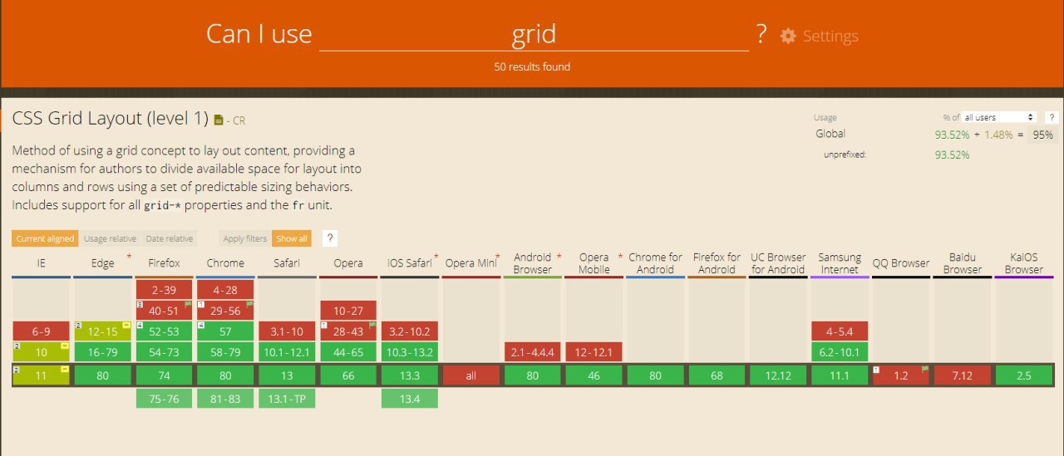
CSS GRID
The CSS Grid Layout Module was developed by the CSS Working Group to provide a better way to create website layouts in CSS. It became a Candidate Recommendation in February 2017, and major browsers started to support grid layout in March 2017.

Slide 3
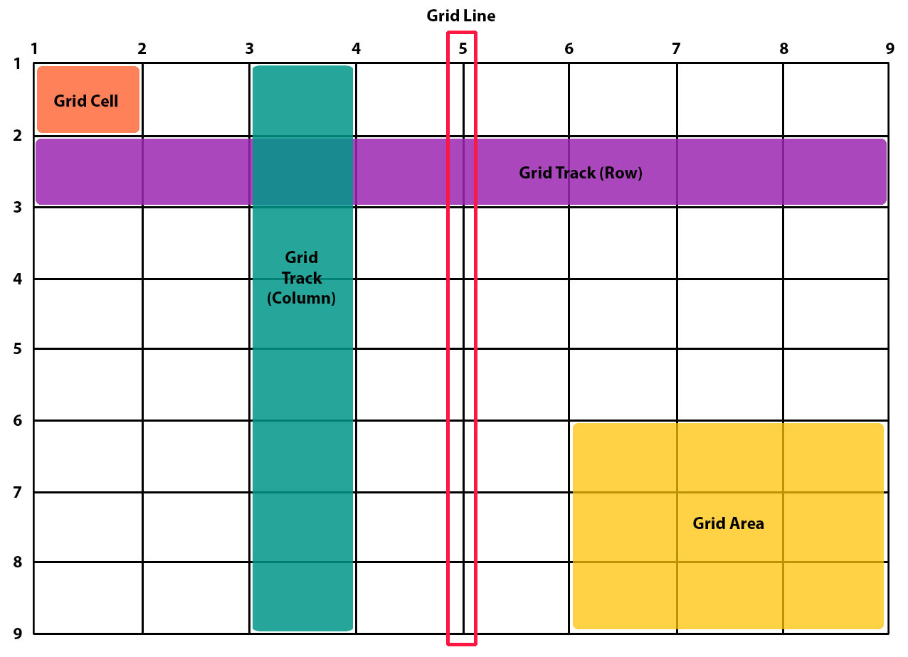
Basic terminology
Grid container - the container that holds the entire CSS grid. It will be the element that has display: grid or inline-grid property on it.
Grid lines - the vertical and horizontal lines that divide the grid and separate the columns and rows.
Grid cell – a single unit of a CSS grid.
Grid area - rectangular space surrounded by four grid lines. A grid area can contain any number of grid cells.
Grid track - space between two grid lines. This space can be horizontal or vertical.le unit of a CSS grid

Slide 4
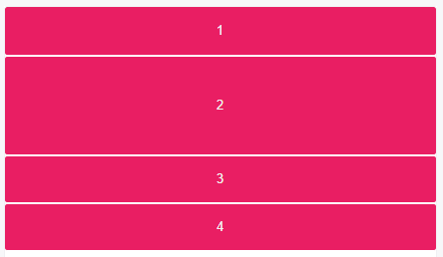
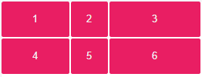
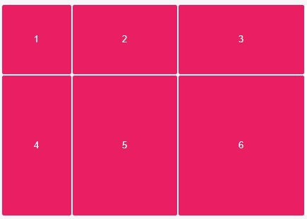

Explicit Grid
Explicitly set a grid by creating columns and rows with the grid-template-columns and grid-template-rows properties.
grid-template-columns: 90px 50px 120px
grid-template-rows: 100px 200px
grid-template-column: 100px 150px 180px
grid-template-rows: 50px 100px
==>
grid-template: 100px 200px/ 100px 150px 180px
grid-template-columns: 1fr 1fr 2fr

Slide 5
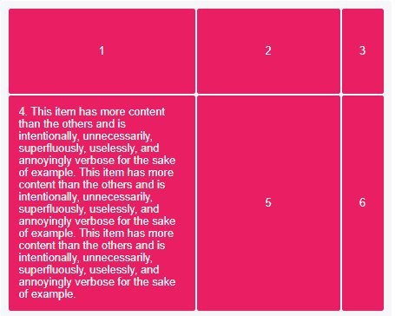
Minimum and Maximum Grid Track Sizes
Tracks sizes can be defined to have a minimum and/or maximum size with the minmax() function.
The minmax() function accepts 2 arguments: the first is the minimum size of the track and the second the maximum size.
grid-template-rows:minmax(100px, auto);
grid-template-columns: minmax(auto, 50%) 1fr 50px;

Slide 6
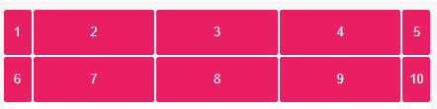
Repeating Grid Tracks
Define repeating grid tracks using the repeat() notation. This is useful for grids with items with equal sizes or many items.
The repeat() notation accepts 2 arguments: the first represents the number of times the defined tracks should repeat, and the second is the track definition.
grid-template-columns: 30px repeat(3, 1fr) 30px

Slide 7
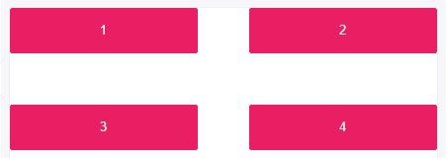
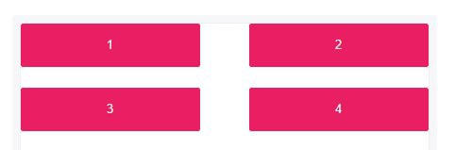
Grid Gaps (Gutters)
The grid-column-gap and grid-row-gap properties create gutters between columns and rows.
Grid gaps are only created in between columns and rows, and not along the edge of the grid container.
grid-row-gap: 20px;
grid-column-gap: 50px;
grid-gap: 50px

Slide 8
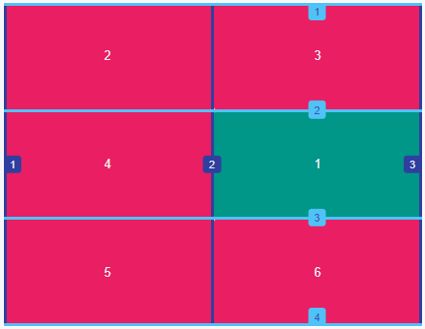
Positioning Items by Grid Line Numbers
Grid lines are essentially lines that represent the start of, the end of, or between column and row tracks.
Each line, starting from the start of the track and in the direction of the grid, is numbered incrementally starting from 1
grid-row-start: 2;
grid-row-end: 3;
grid-column-start: 2;
grid-column-end: 3;

Slide 9
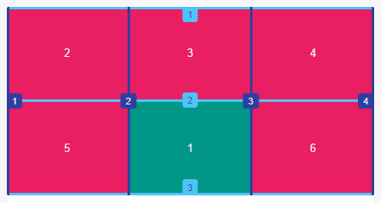
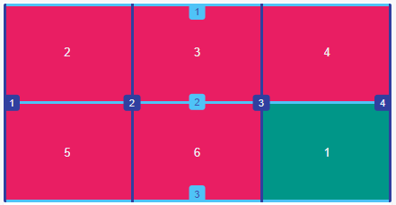
Positioning Items by Grid Line Numbers
grid-row is shorthand for grid-row-start and grid-row-end.
grid-column is shorthand for grid-column-start and grid-column-end.
grid-area is shorthand for grid-row-start, grid-column-start,
grid-row-end and grid-column-end.
grid-row: 2;
grid-column: 3 / 4;
grid-area: 2 / 2 / 3 / 3

Slide 10
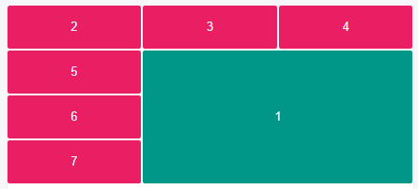
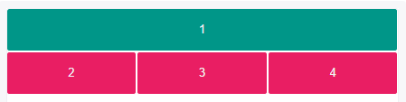
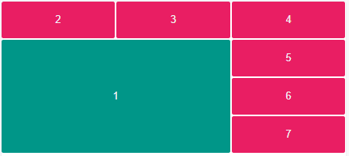
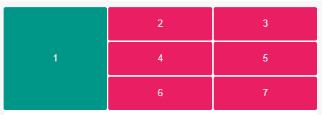
Spanning Items Across Rows and Columns
Grid items span only one column and row track by default, but can span multiple row and/or column tracks using the same properties to position them.
grid-row: 2 / 5;
grid-column: 2 / 4;
grid-column-start: 1;
grid-column-end: 4;
grid-row-start: 1;
grid-row-end: 4;
grid-row: 2 / span 3;
grid-column: span 2;

Slide 11
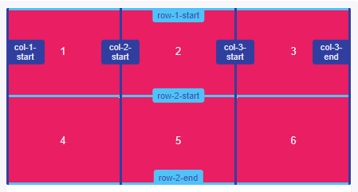
Naming Grid Lines
Grid lines can be named when defining the grid with the grid-template-rows and grid-template-columns properties. Line names can then be referenced to position grid items.
In line names, avoid keywords that appear in the specification to not cause confusion.
Assigned line names must be wrapped in square brackets
[name-of-line] and placed relative to the grid tracks.
grid-template-rows: [row-1-start] 1fr [row-2-start] 1fr [row-2-end];
grid-template-columns: [col-1-start] 1fr [col-2-start] 1fr
[col-3-start] 1fr [col-3-end];

Slide 12
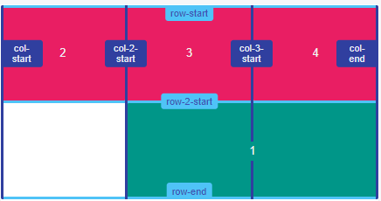
Positioning Items by Line Names
With named grid lines, items can be positioned by line names and numbers.
Referenced line names should not be wrapped in square brackets.
grid-row-start: row-2-start;
grid-row-end: row-end;
grid-column-start: col-2-start;
grid-column-end: col-end;

Slide 13
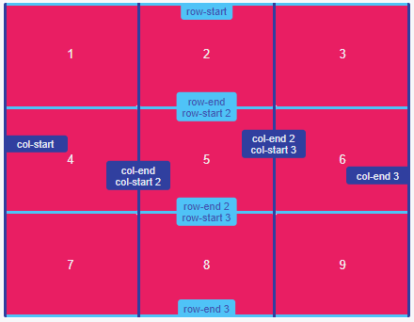
Naming and Positioning Items by Grid Lines with the Same Name
Lines can be assigned the same name with the repeat() function. This can save you time from having to name each line in track definitions.
Lines with the same name are also assigned the a line’s position/name’s occurrence number, which allows it to be uniquely identified from another line with the same name.
grid-template-rows: repeat(3, [row-start] 1fr [row-end]);
grid-template-columns: repeat(3, [col-start] 1fr [col-end]);

Slide 14
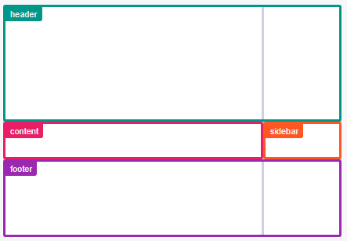
Naming and Positioning Items by Grid Areas
Like grid line names, grid areas can also be named with the grid-template-areas property. Names can then be referenced to position grid items.
Sets of names should be surrounded in single or double quotes,
and each name separated by a whitespace.
Each set of names defines a row, and each name defines a
column.
grid-template-areas: "header header"
"content sidebar"
"footer footer";
grid-template-rows: 150px 1fr 100px;
grid-template-columns: 1fr 200px;

Slide 15
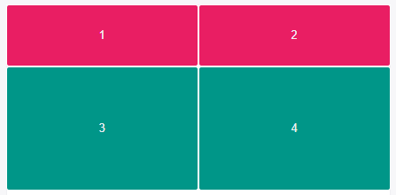
Implicit Grid
An implicit grid is created when a grid needs to position items outside of the explicit grid because there isn’t enough space for items in the explicitly defined tracks or you decide to position something outside of the explicit grid. Those items are then auto-placed in the implicit grid.
The implicit grid can be defined using the grid-auto-rows, grid-auto-columns, and grid-auto-flow properties.
grid-template-rows: 70px;
grid-template-columns: repeat(2, 1fr);
grid-auto-rows: 140px;

Slide 16
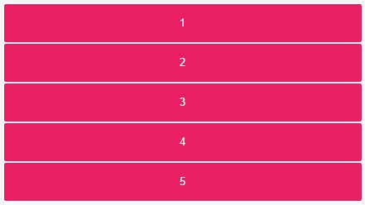


Implicit Grid
grid-auto-flow: row;
grid-template-columns: 30px 60px;
grid-auto-flow: column;
grid-auto-columns: 1fr;
grid-auto-flow: column

Slide 17
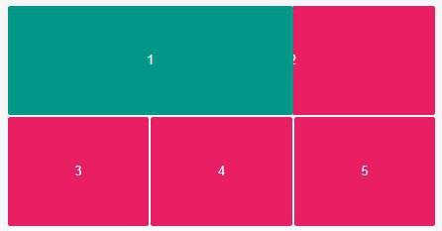
Layering Grid Items
Grid items can be layered/stacked by properly positioning them and assigning z-index when necessary.
.item-1,
.item-2 {
grid-row-start: 1;
grid-column-end: span 2;
}
.item-1 { grid-column-start: 1; z-index: 1; }
.item-2 { grid-column-start: 2 }

Slide 18
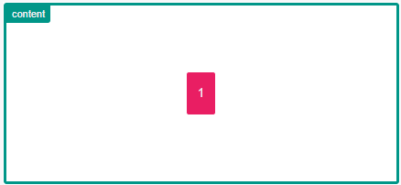
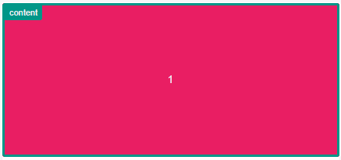
Aligning Grid Items (Box Alignment)
CSS’s Box Alignment Module complements CSS Grid to allow items to be aligned along the row of column axis.
justify-items and justify-self align items along the row axis
align-items and align-self align items along the column axis.
justify-items and align-items are applied to the grid container and support the following values: auto, normal, start, end, center, stretch, baseline, first baseline, last baseline
justify-items: center;
align-items: center;
justify-items: stretch

Slide 19
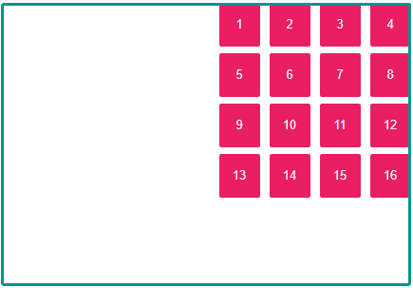
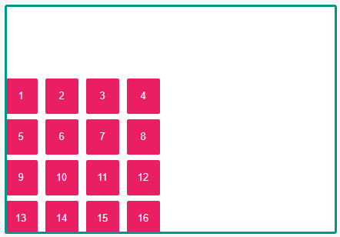
Aligning Grid Tracks
Grid tracks can be aligned relative to the grid container along the row and column axes.
align-content aligns tracks along the row axis and justify-content along the column axis.
align-content aligns tracks along the row axis and justify-content along the column axis. They support the following properties: normal, start, end, center, stretch, space-around, space-between, space-evenly, baseline, first baseline, last baseline
justify-content: end;
align-content: end;

Slide 20


